Slide 2
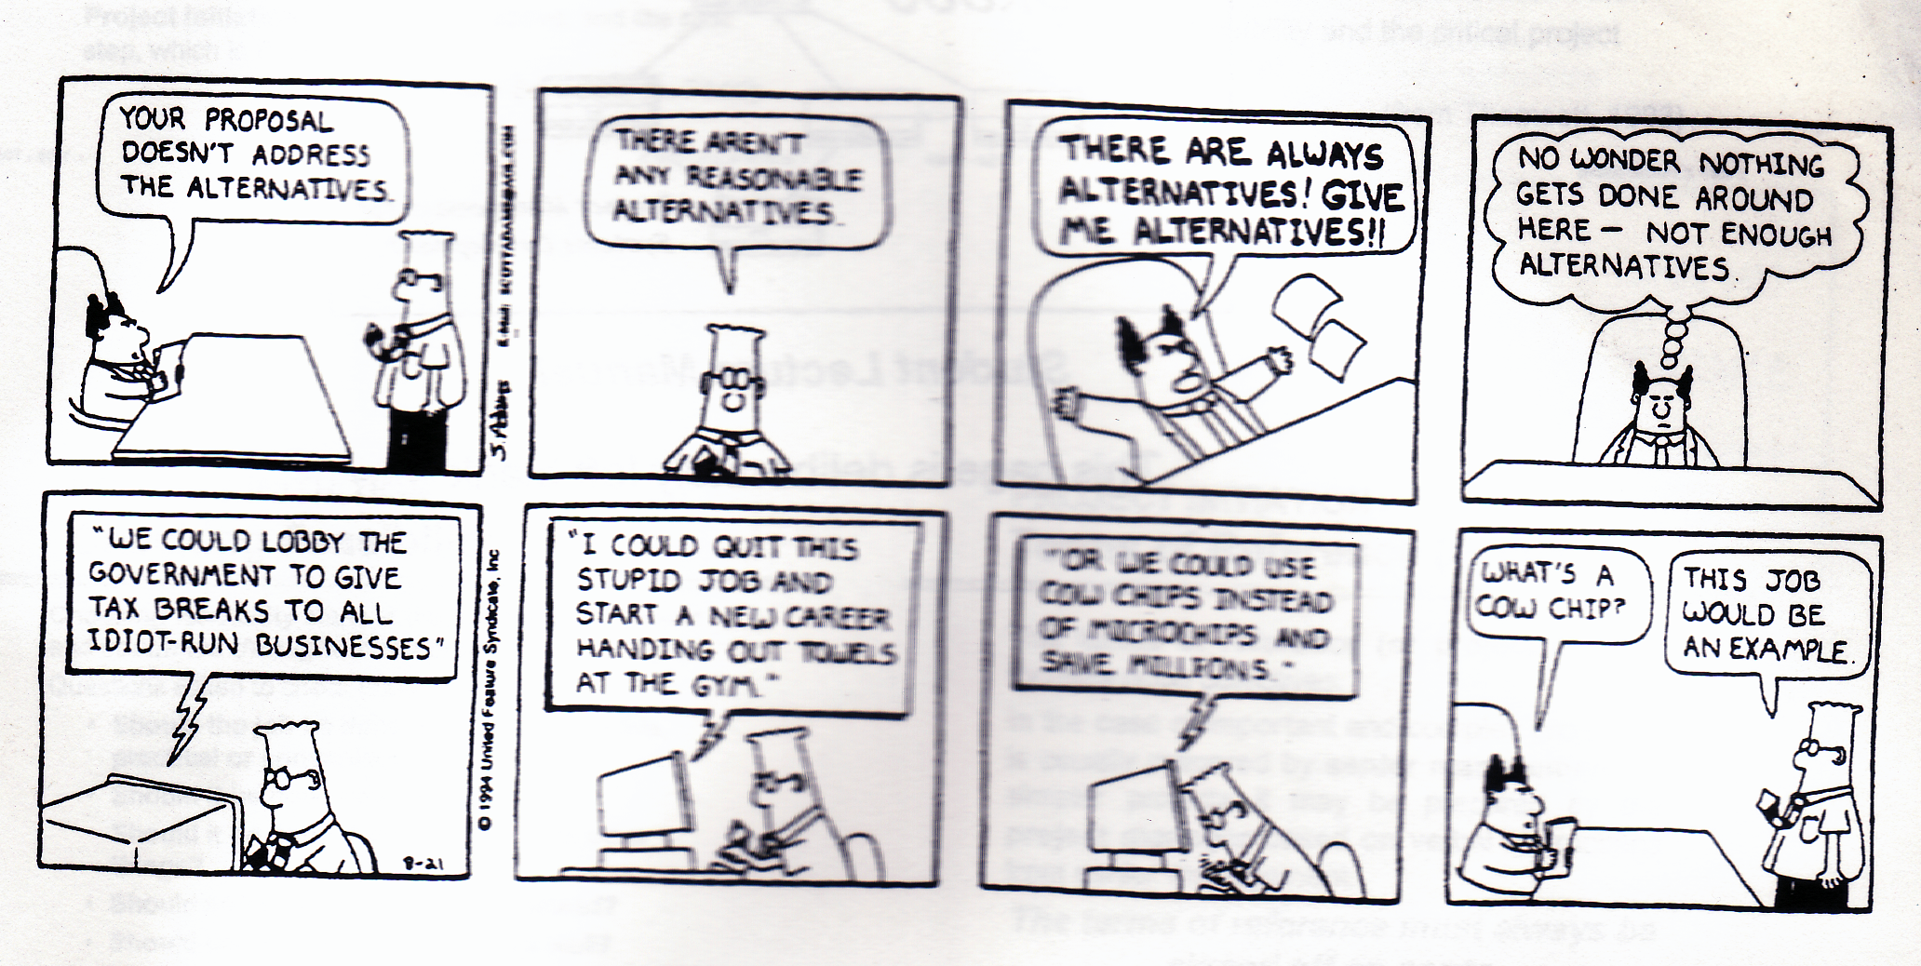

Slide 3
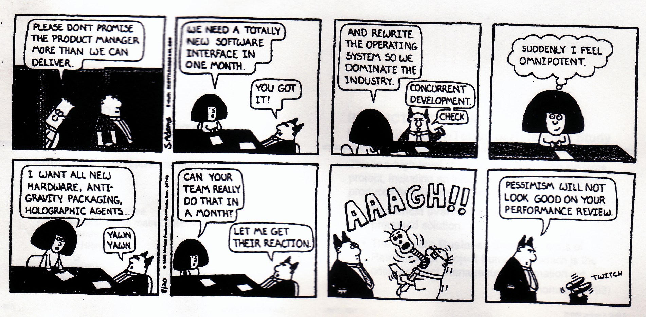

Slide 4
When we do project management….

Slide 5
Terminology
Organizations typically divide a project into project phases to improve management control
Collectively, these project phases are called the project life cycle. The project life cycle defines…
the beginning and the end of a project
what technical work should be done at each phase
who should be involved at each phase

Slide 6
Project Management consists of five phases as per PMBOK
Define & Organize
Plan the project
Initiating Processes
Planning Processes
Controlling
Processes
Executing
Processes
Manage Project
Progress
Closing Processes

Slide 7
Each of them has the following objective…
Sets the foundation of the project
Establishes detailed project plans of
the project
The project manager controls the project by
monitoring it’s progress
Occurs when the project’s end product is
complete

Slide 8
And each phase has the following tasks…
Step 1 : Define the project
Step 2: Generate Tasks
Step 3: Determine Roles and Responsibilities
Step 4: Define Task Interdependences
Step 5: Develop Schedule
Step 6: Generate Budget
Step 7: Allocate Resources
Step 8: Develop Risk Management
Step 9: Track and Manage the Project
Step 10: Perform Post-Project Review

Slide 9
The Project Life Cycle
Definition
Planning
Execution
Delivery
1. Schedules 2. Budgets 3. Resources 4. Risks 5. Staffing
1. Train customer 2. Transfer documents 3. Release resources 4. Reassign staff 5. Lessons learned
Level of effort
1. Goals 2. Specifications 3. Tasks 4. Responsibilities 5. Teams
1. Status reports 2. Changes 3. Quality 4. Forecasts

Slide 10
As Against the SDLC
Project Management
Reviews
Status Reports
Documentation
User Training

Slide 11
As against the relative effort
Past slides are from Rakos [1990], Software Project Management for Small to Medium Sized Projects

Slide 12
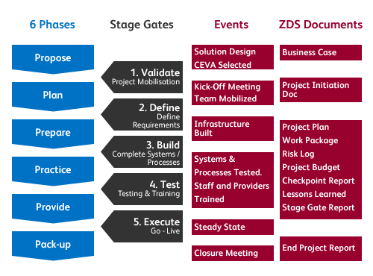
PM Framework of CEVA Logistics (Supply Chain Company)

Slide 13
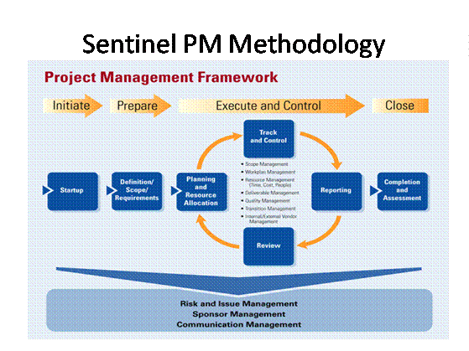
PM Framework of Sentinel (IT Development)
TQM + Six Sigma

Slide 14
Holcim’s Project Management Approach
Phase I
Phase II
Phase III
Phase IV
Phase V
Project
Definition
Project
Planning
Project
Realization
Project
Completion
Project
Evaluation
& Transfer
Initiation &
Definition
Execution & Control
Planning
Closure

Slide 15
Phase 1: Project Initiation & Definition…

Slide 16
Phases
Step 1 : Define the project
Step 2: Generate Tasks
Step 3: Determine Roles and Responsibilities
Step 4: Define Task Interdependences
Step 5: Develop Schedule
Step 6: Generate Budget
Step 7: Allocate Resources
Step 8: Develop Risk Management
Step 9: Track and Manage the Project
Step 10: Perform Post-Project Review

Slide 17
What is Project Initiation and Definition?
Project Initation is the process of formally authorizing a new project or recognizing that an existing project should continue into it’s next phase.
The following are created during this phase
project scope
deliverables
objectives
project team
project expectations

Slide 18
Process
Determine the
real need
Define the
end product
Prepare the project
definition document
Determine the
priorities for the
project

Slide 19
At this phase, the following components are identified…
Component | Description
Project Mission | What are it’s goals and deliverable
Constraints | How much money and time is available and what quality is required?
Focus | Is everyone committed to the project?
Critical Success Factors | What must be achieved to guarantee it’s success, what should not be included as part of the project.
Objectives | How is it intended to read the end deliverable; what are the milestones
Risks | What can go wrong and what actions can be taken?

Slide 20
Project Charter
A project charter is a document that formally authorizes a project.
It should include, either directly or by reference to other documents:
The business need that the project was undertaken to address.
The product description
The project charter should be issued by a manager external to the project, and at a level appropriate to the needs of the project. It provides the project manager with the authority to apply organizational resources to project activities.

Slide 21
Project vs. Product Scope
Project scope—the work that must be done to deliver a product with the specified features and functions. Completion of the project scope is measured against the project requirements
Product scope—the features and functions that characterize a product or service. Completion of the product scope is measured against the product requirements.

Slide 22
Project Scope Checklist
Project Objectives
brief summary of essential proj. information (who, what, why, optional : when & cost)
Deliverables
typically will include time, quantity and cost estimates
Measures of Success

Slide 23
Project Scope Checklist
Milestones
Important control points in the project
Technical requirements
Limits and Exclusions
Reviews with customer

Slide 24
A Word on: Measures of Success
Measures of success are the criteria that show the impact of a project
The measures may be quantifiable or qualitative but they must be observable!

Slide 25
A Word on: Measures of Success
Measures of success should tell us the following about whether the goals:
Achieved the results we expected
Produced results we didn’t want or expect
Should be changed
Should continue (or not)
Should be measured in other ways

Slide 26
Other Components
Project Infrastructure
Project Team Composition
Roles, Responsibilities, Accountabilities, Authority
Organizational Realities (politics)
Interfaces
Communications Plan
Project notebook composition

Slide 27
Project Priorities
Constrain : Original parameter is fixed
Accept : Criterion is tolerable not to meet the original parameter
Optimize : Given the scope of the project, which criterion should be optimized?

Slide 28
Organizational Structure Influences on PM

Slide 29
Some Sample Project Organizations
Functional Organization
Project staff members are grouped by specialty; perceived scope is limited to the boundaries of the function
Projectized Organization
Organizations resources are dedicated to project work; PMs are independent
Strong Matrix Organization
Blend of functional and projectized organization leaning more toward the second type

Slide 30
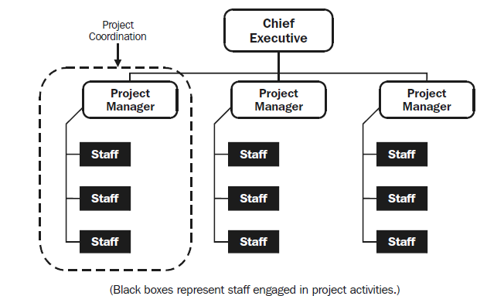
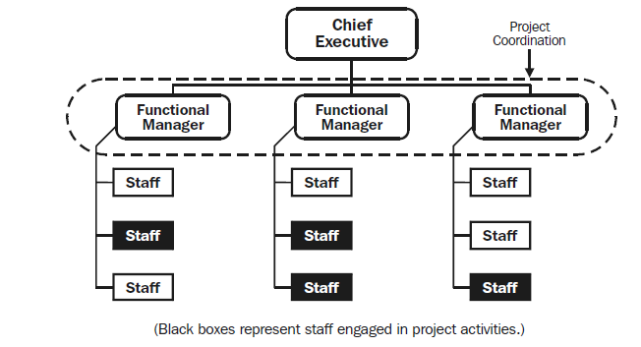
Different PM Organizational Structures
Functional
Projectized

Slide 31
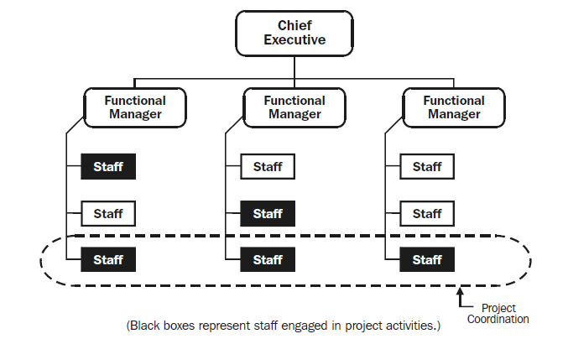
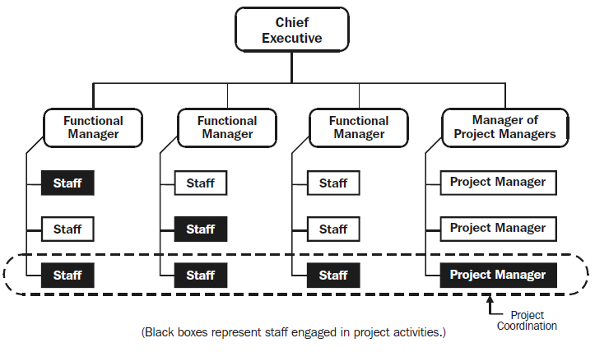
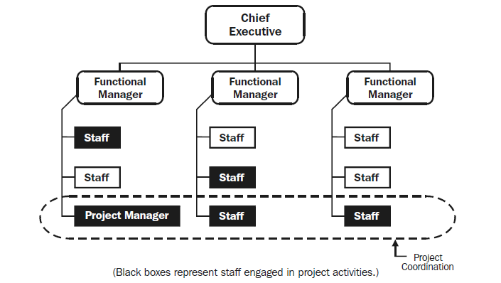
Different PM Organizational Structures
Weak Matrix
Strong Matrix
Balanced Matrix

Slide 32
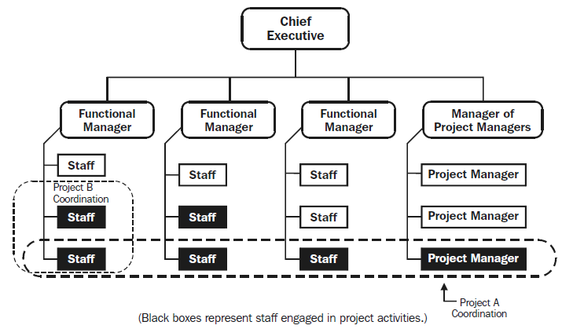
Different PM Organizational Matrix
Composite Organization

Slide 33
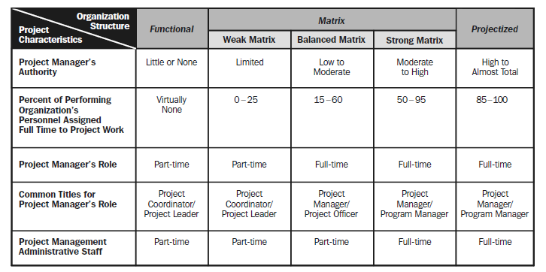

Slide 34
The Stakeholders
Individuals and/or organizations that are actively involved in the project or whose interests may be positively or negatively affected as a results of project completion
Key stakeholders
PM, customer, project team members, project sponsor

Slide 35
The Sponsor
Champions the project and uses their influence to gain approval of the project
They shelter the project from interference
Should always be informed of any action

